Slide 1
Pol-PRIMETT II – London Conference
“Cross border mapping and analysis of metal theft within the EU”
José Pires
Rail Security Senior Advisor - UIC
16 September 2015

Slide 2


Slide 3
Metal theft is a Crime

Slide 4



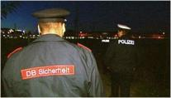
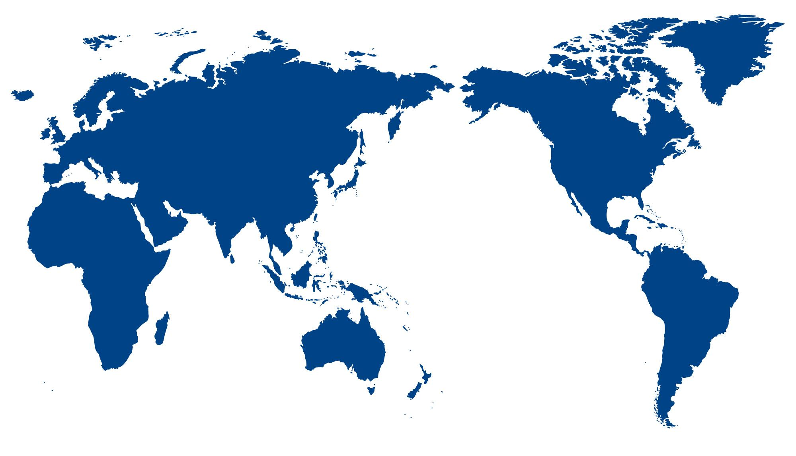
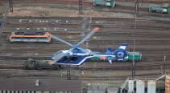

Slide 5
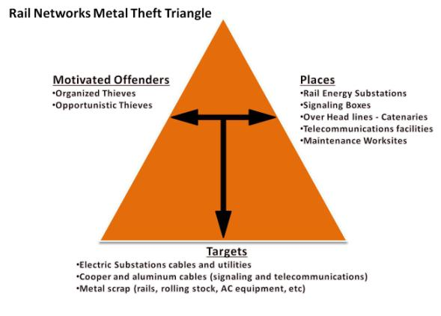
Metal theft, the railway context, but not just…

Slide 6
Next time your train is delayed or cancelled due to "signalling problems" there's a good chance it will be the fault of metal thieves.

Slide 7
Even if a single cm/inch of cable is taken it can translate into long delays!!!

Slide 8
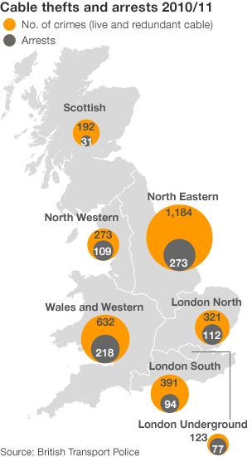
One copper cable theft from a railway line. The result?
A total of 108 trains delayed, 17 hours worth of hold-ups for thousands of passengers and damage put at over £80,000. Plus, probably, £50 for the thieves.
(Source: Denise Winterman, BBC News Magazine)

Slide 9

Mapping Metal Theft across the EU?

Slide 10
  Need for EU (global) common criteria when collecting and analysing metal theft related data:
      Events definition (within the existing rail incidents indicators)
      Typology of events
      Interoperability of criteria

Slide 11
  Need to answer to Law Enforcement Authorities (LEA) needs:
      Cooperation with private public/sector
      Increase of awareness ( LEA’s and sectors)
      Establish a network of practitioners
      Identification and exchange of good practices ( creation of Codes of Practice)
      National and International actions coordination ( inter sectors & LEA’s)
      Strategic actions effectiveness evaluation

Slide 12
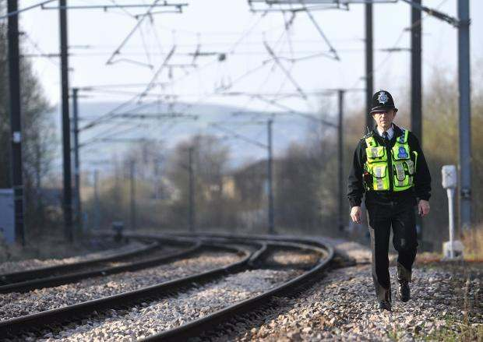
Concerted effort to reduce cable theft on railway sees train delays drop by 93 per cent.
(Source: Rhys Thomas, T&A Reporter / Monday 15 April 2013 /)

Slide 13
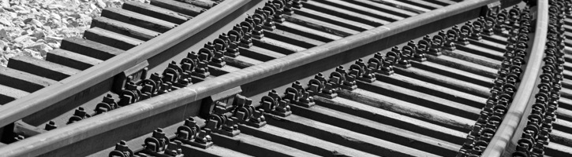
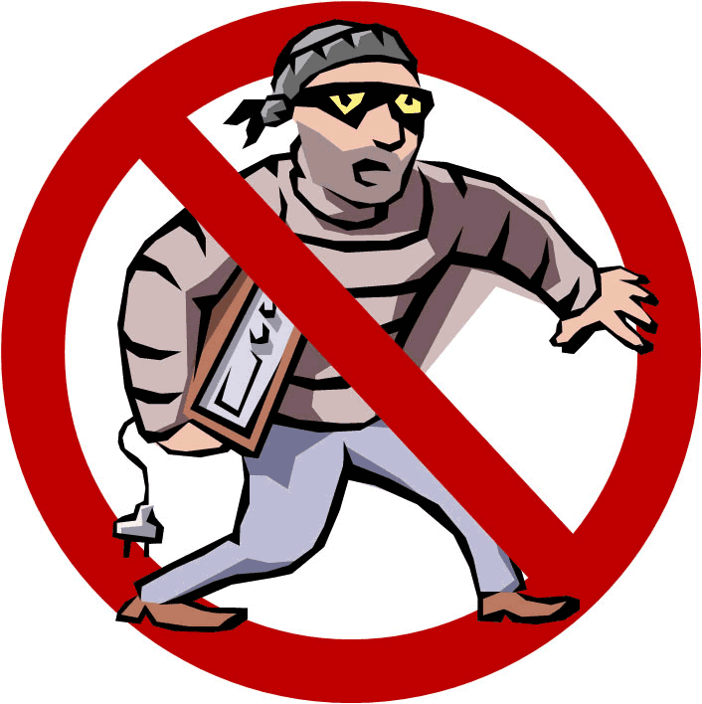
Conclusion
  Metal theft is far from being mitigated and it is in fact affecting multiple industries and by consequence society. Railways’ response to this problem can and must be consistent across Europe having as a common and single objective “Mitigate metal theft and its impacts on railway users.”

Slide 14
Thank you for your kind attention and we will be happy to answer any questions.
For more information please visit us @ the UIC website on security activities http://www.uic.org/security

